Slide 1
Demographic Effects in Latent Fingerprint Matching and their Relation to Image Quality
Author:
EMANUELA MARASCO, George Mason University
MENGLING HE, University of Central Florida
LARRY TANG, University of Central Florida
YUANTING TAO, George Mason University

Slide 2
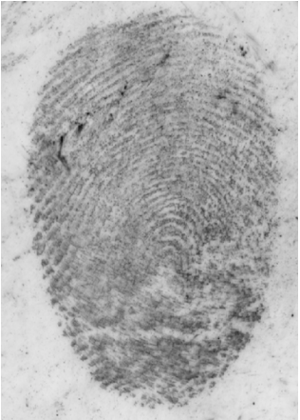
Introduction
The contribution of this paper is three-fold:
Investigate how demographic differentials affect the latent fingerprint image quality
Study how demographics impact automatic matching of latent fingerprints of the same quality
Discuss the use of covariate-specific ROC regression incorporating not only demographics but also LFIQ measures conditioned on image quality
Sample Latent fingerprints pertaining to the FBI Biometric Collection (BioCoP) Next Generation Identification Phase 1 (2008 - 2009) collected at West Virginia University

Slide 3
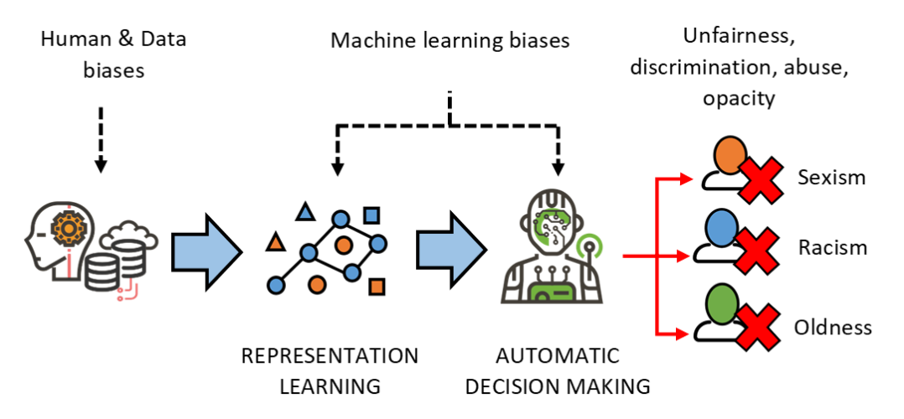
Background
source: https://sensitivenets.com/what/

Slide 4
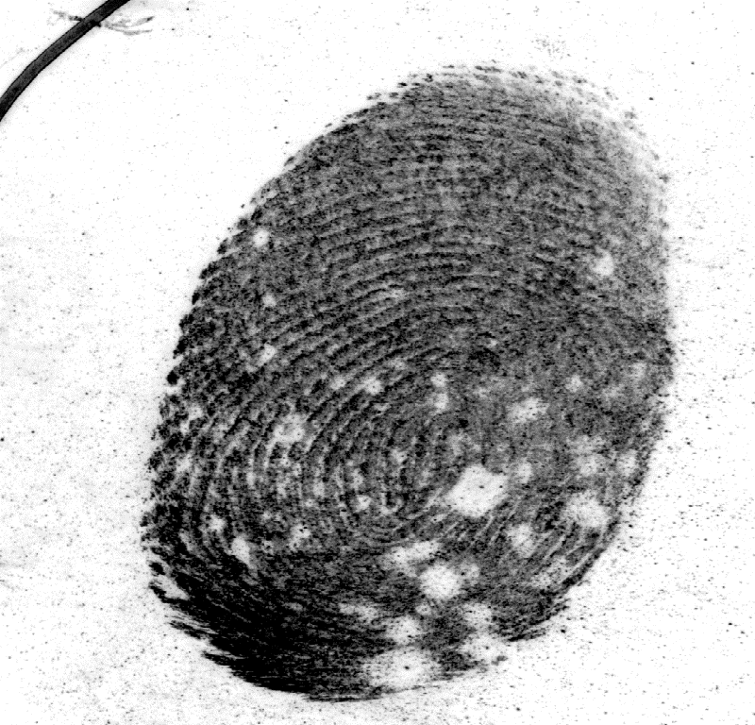
Motivation
Crystal Huynh et al. 2015. Forensic identification of gender from fingerprints.
Soweon Yoon et al. 2015. Longitudinal study of fingerprint recognition.
Cynthia M. Cook et al. 2019. Demographic Effects in Facial Recognition and Their Dependence on Image Acquisition: An Evaluation of Eleven Commercial Systems.
Deborah Hellman. 2020. Measuring Algorithmic Fairness.
FBI Biometric Collection (BioCoP)

Slide 5
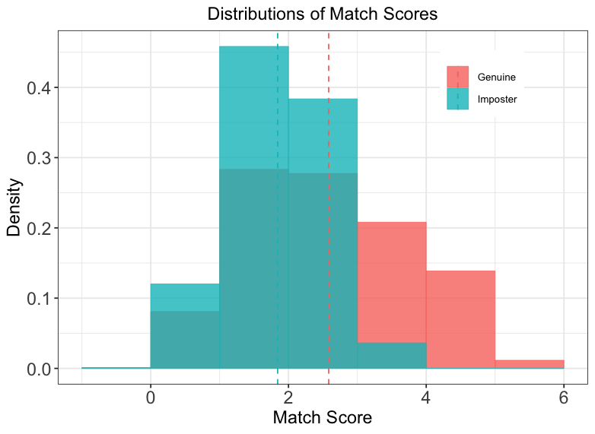
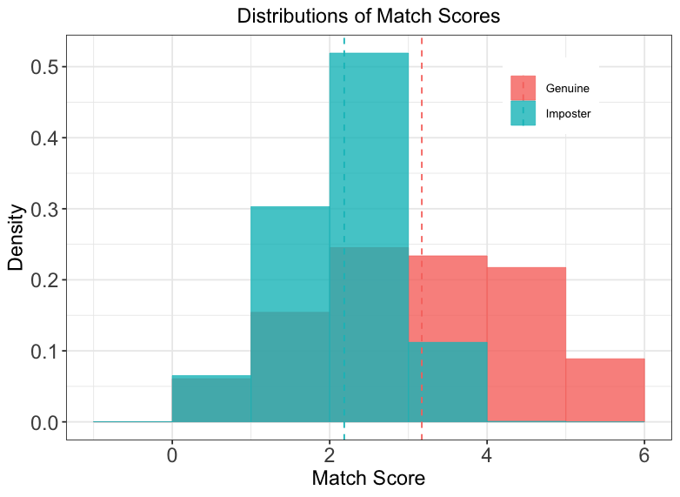
Dataset
Fingerprint
FBI BioCoP Next Generation Identification Phase 1 (2008 - 2009)
Latent-to-reference print comparison
Match Scores used end-to-end latent fingerprint search system at Michigan State University
LFIQ
(Latent Fingerprint Image Quality Score)
Minutiae extraction: MinutiaeNet
Covariate: gender; age; ethnicity
469 right-thumb, 219 right-index
LFIQ computation

Slide 6
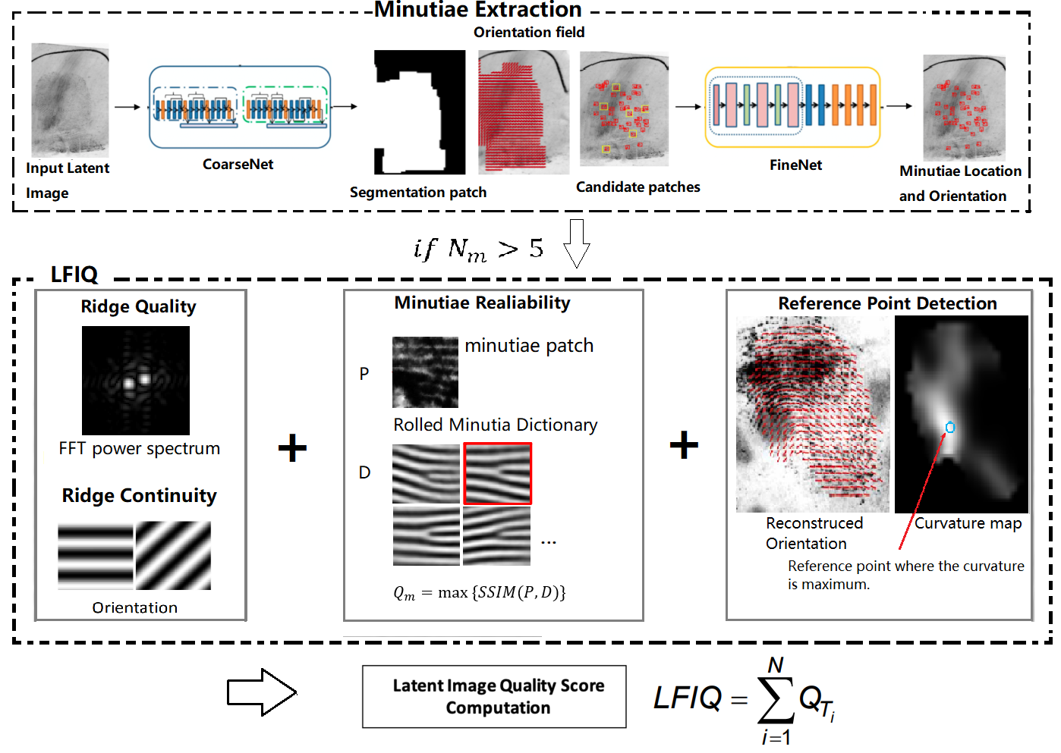

Slide 7

The Proposed Approach
$$ROCx\left(u\right)=1−G1[{G0}^{−1}\left(1−u\right)\frac{σ0\left(x\right)}{σ1\left(x\right)}−\frac{μ1(x)−μ2(x)}{σ1(x)}]$$
𝑅𝑂𝐶_{𝑥(}𝑢)=1−𝐺₁[〖𝐺_{0〗^(}−1) (1−𝑢) 𝜎₀₍𝑥)/𝜎₁₍𝑥) −(𝜇₁(𝑥)−𝜇₂(𝑥))/(𝜎₁(𝑥))]
Covariate-specific ROC curve
Linear Regression

Slide 8
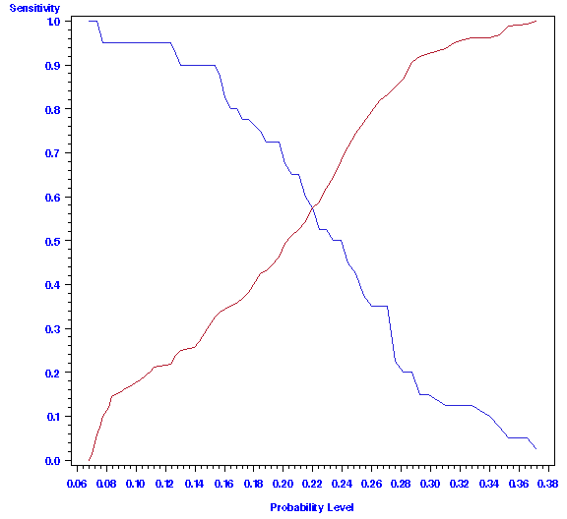
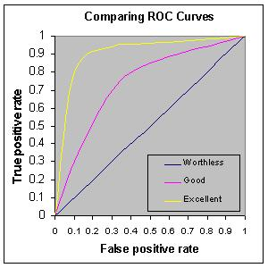
ROC Curve (Zhou, et al., 2009; Pepe, 2004)
For a given cut-point c,
Sensitivity = proportion of genuine scores > c
Specificity = proportion of imposter score ≤ c
Sensitivity
Specificity
Sensitivity
1 - specificity=FPR
The area under the ROC curve (AUC) is a measure of classification accuracy.

Slide 9

The Proposed Approach
Pervious work: Emanuela Marasco, Mengling He, Larry Tang, and Sumanth Sriram. 2020. Accounting for Demographic Differentials in Forensic Error Rate Assessment of Latent Prints via Covariate-Specific ROC Regression. CVIP 2020 CCIS 1376 (2020), 338–350.
old model : Score $=β_{0}+β_{L}∗$ label $+β_{11}∗$ Age $_{Q}+β_{12}∗$ Age $_{R}+β_{21}∗$ Gender $_{Q}$ $+β_{22}∗$ Gender $_{R}+β_{31}∗$ Ethnicity $_{Q}+β_{32}∗$ Ethnicity $_{R}+β_{L11}∗$ Age $_{Q}∗$ l$β$abel $+β_{L21}∗$ Gender $_{Q}∗$ label $+β_{L31}∗$ Ethnicity $_{Q}∗$ label
+ Latent Fingerprint Image Quality (LFIQ)
"How do demographics affect the matching of latent fingerprints of same image quality?“
new model $:\begin{matrix} \text{Score} = & β_{0}+β_{L}∗ \text{label} +β_{1}∗ \text{LFIQ} +β_{2}∗{ \text{Age} }_{Q}+β_{3}∗{ \text{Age} }_{R}+β_{4}∗{ \text{Gender} }_{Q}+β_{5}∗{ \text{Gender} }_{R} \\ & +β_{6}∗{ \text{Ethnicity} }_{Q}+β_{7}∗{ \text{Ethnicity} }_{R}+β_{L1}∗ \text{LFIQ} ∗ \text{label} +β_{L2}∗{ \text{Age} }_{Q}∗ \text{label} \\ & +β_{L3}∗{ \text{Gender} }_{Q}∗ \text{label} +β_{L4}∗{ \text{Ethnicity} }_{Q}∗ \text{label}\text{.} \end{matrix}$

Slide 10
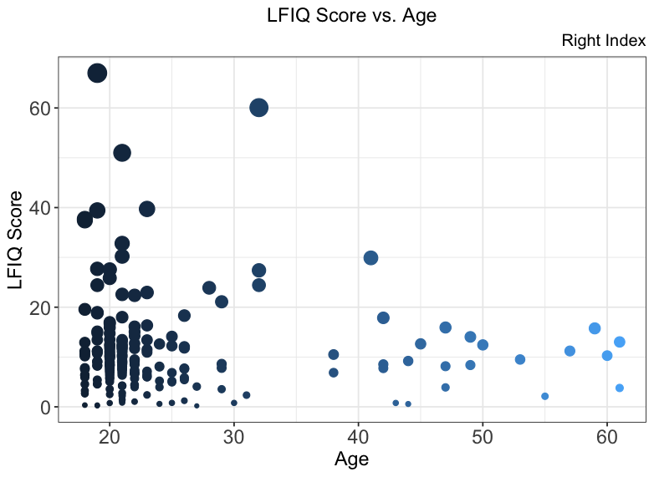
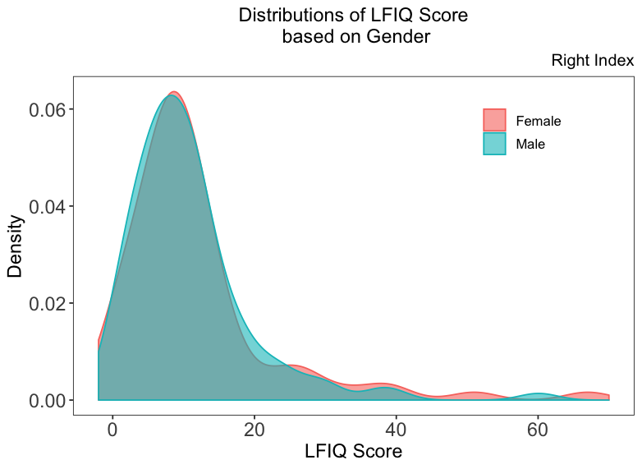
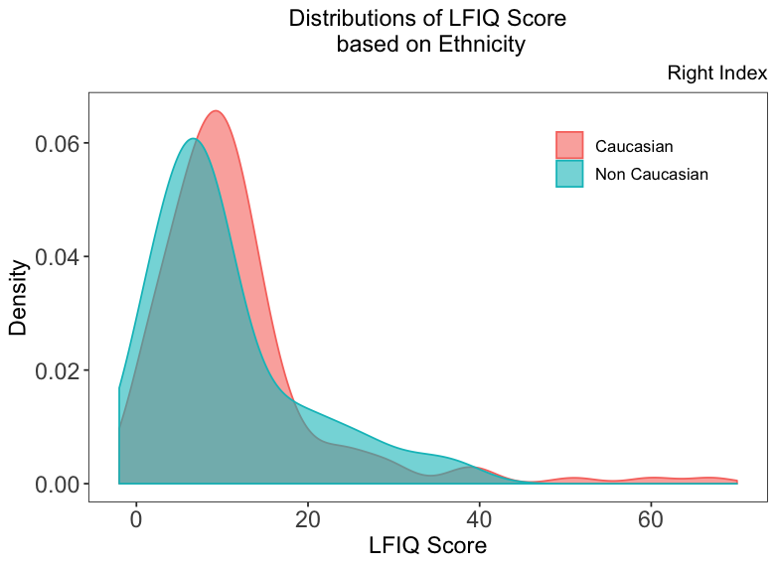
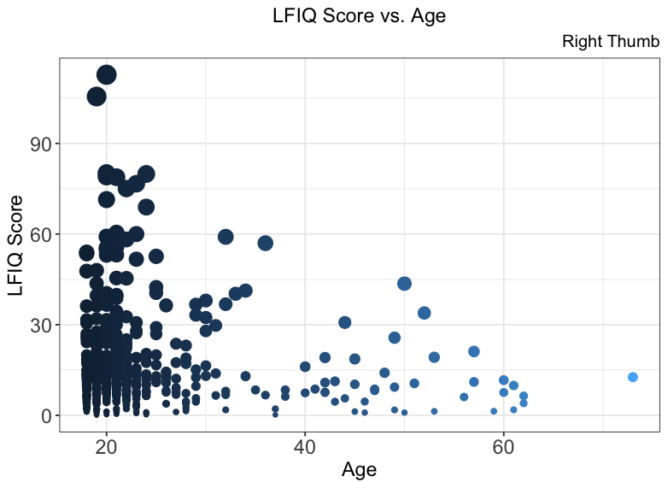
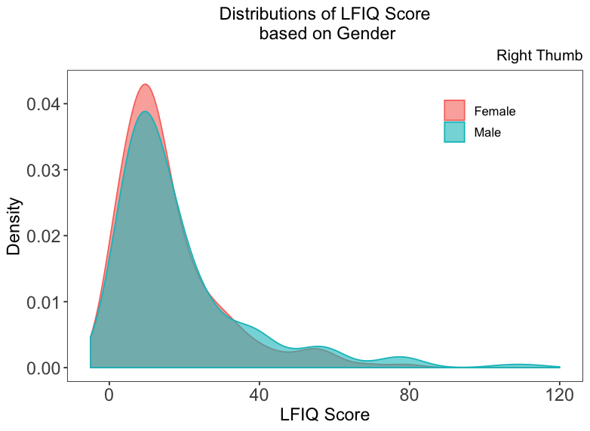

Results
how demographic differentials affect the latent fingerprint image quality

Slide 11
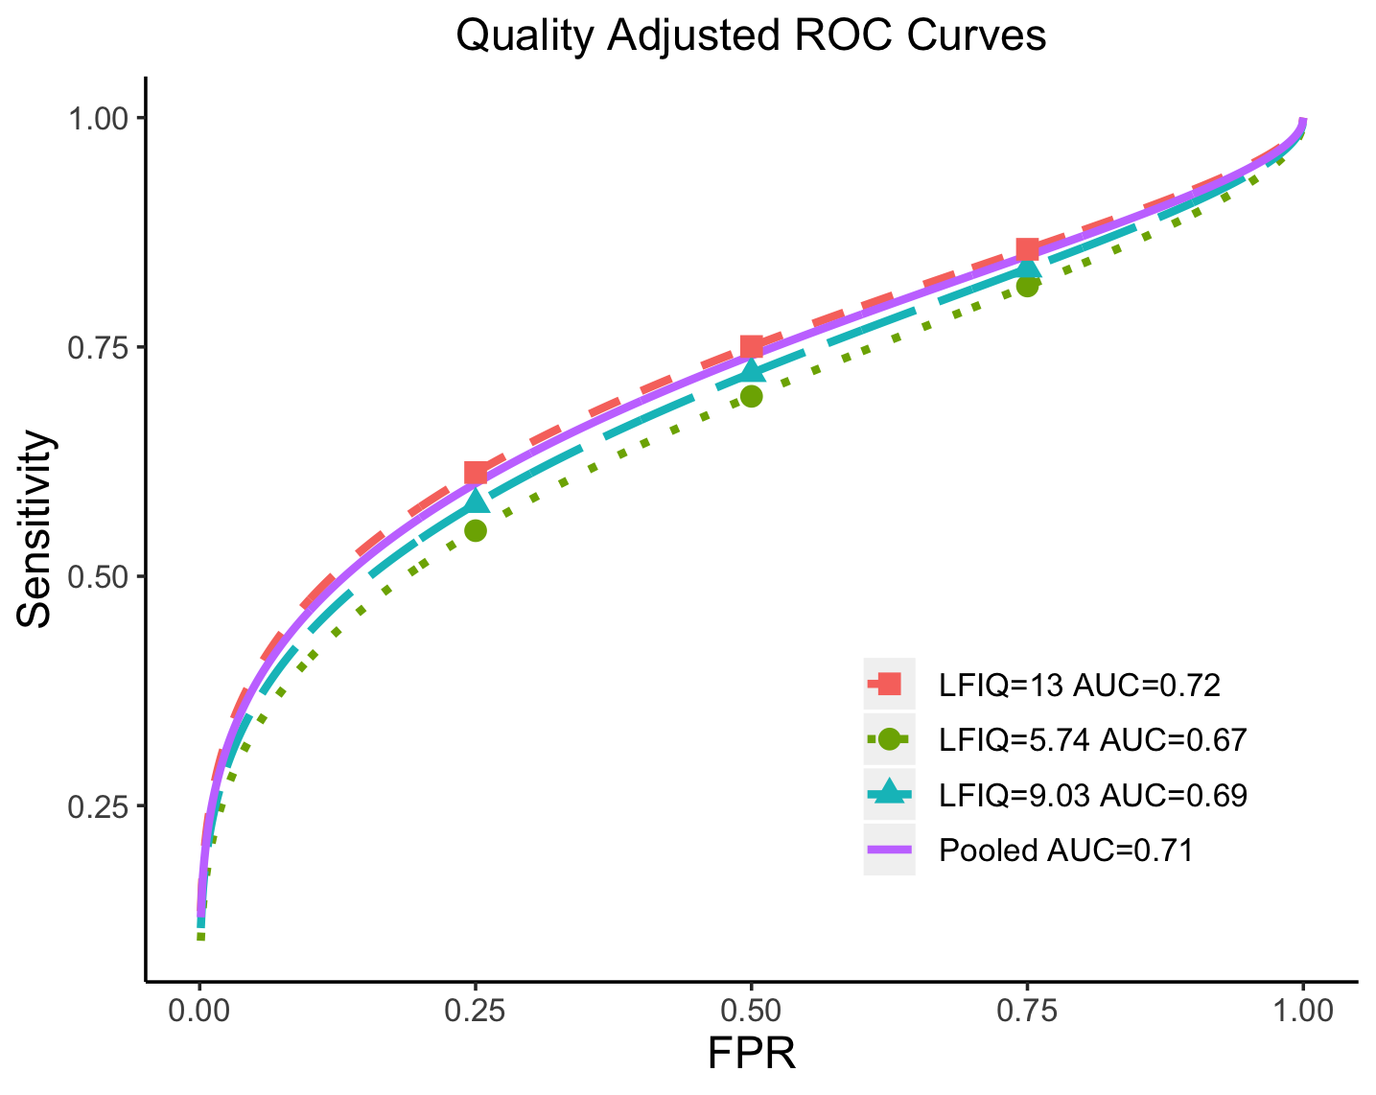
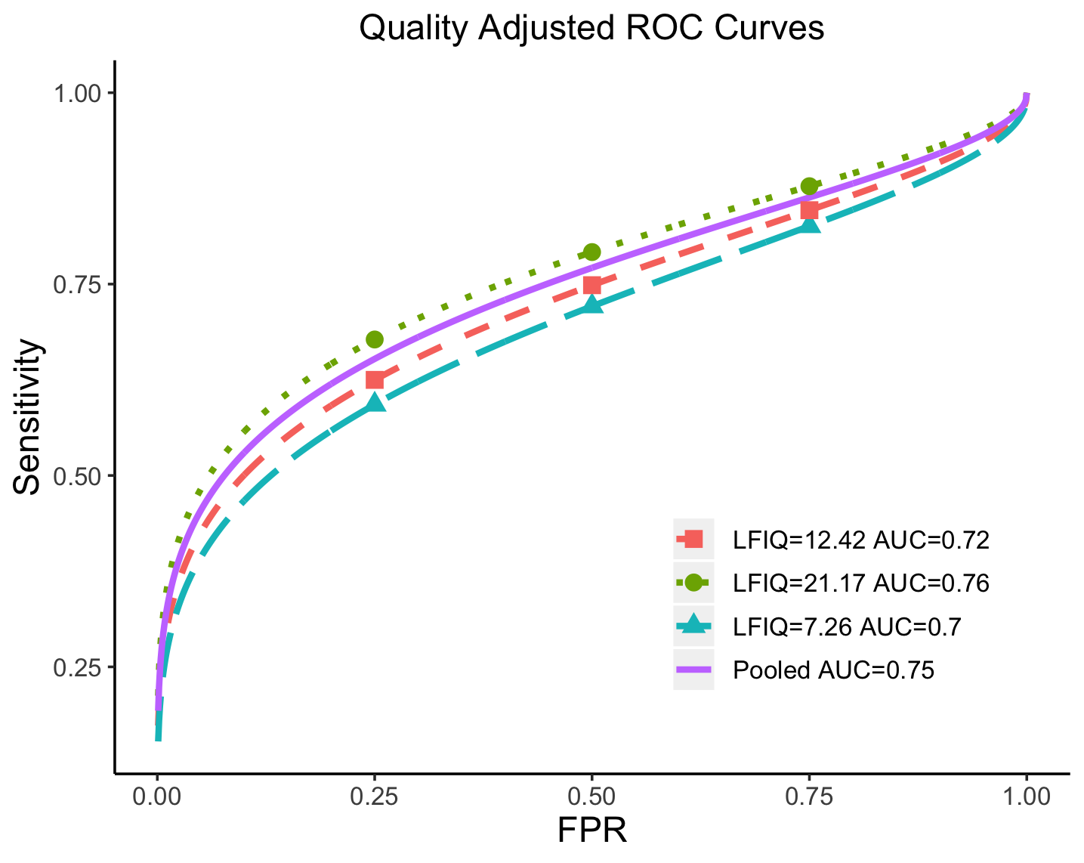
Model Results
Model with only LFIQ
Index fingerprint
thumb fingerprint
The 25𝑡h, 50𝑡h, and 75𝑡h percentiles of LFIQ score were chosen to compute the curves.
As LFIQ score increases, the model’s identifying ability increases.

Slide 12
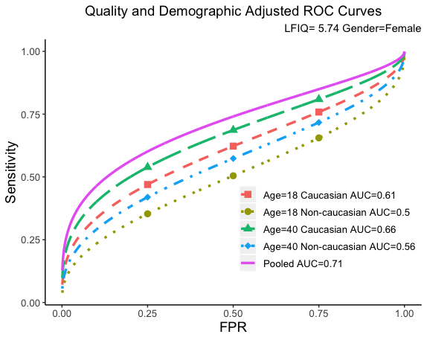
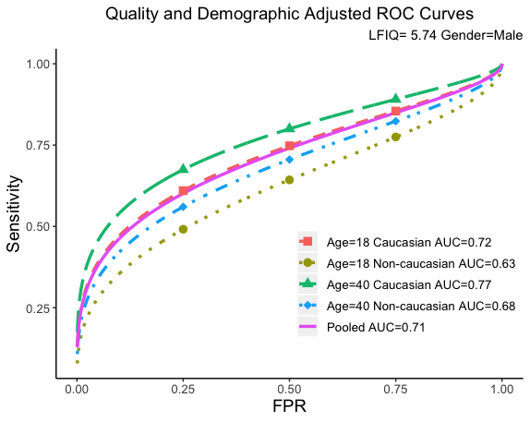
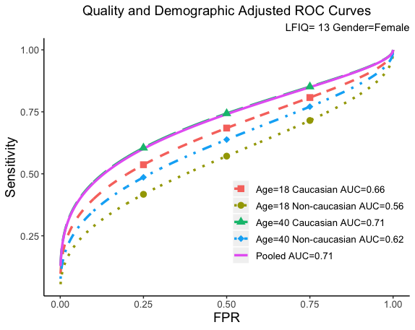
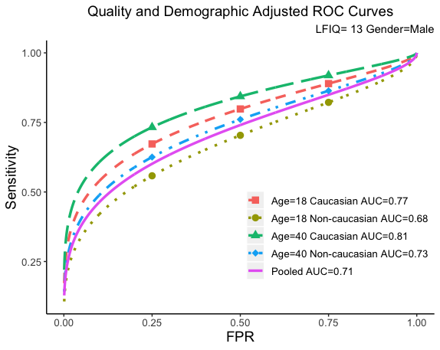
--Model with LFIQ and demographics (right index data)
Model Results
When demographics are constant, larger LFIQ scores lead to higher identifying ability
Gender: Model performs significantly better for male subjects
Age: Model performance better for elder subjects.
Ethnicity: Model performs better in Caucasian subjects than the Non-Caucasian ones

Slide 13
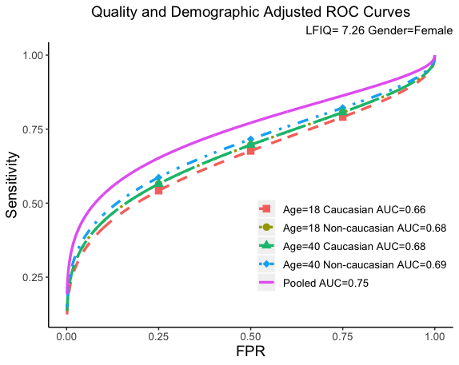
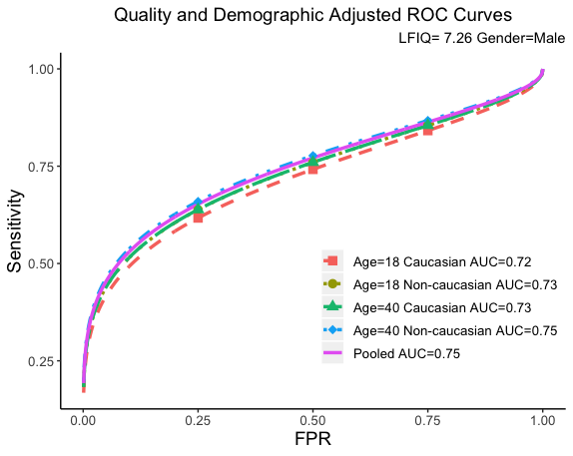
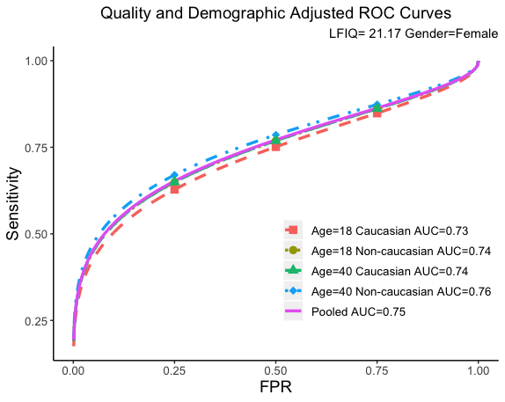
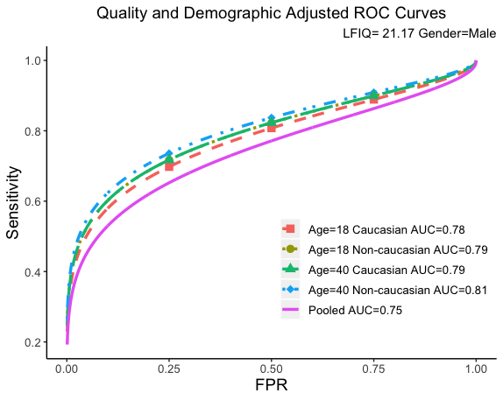
Model Results
-- Model with LFIQ and demographics (right thumb data)
When demographics are constant, larger LFIQ scores lead to higher identifying ability
Gender: Model performs significantly better for male subjects
Age: Model performance slightly better for elder subjects.
Ethnicity: Model performs slightly better in Non-Caucasian subjects than the Caucasian ones

Slide 14
Conclusion & Future prospective
When demographics are constant, larger LFIQ scores will improve identifying ability
Demographics biases will impact automated matching model for latent fingerprints conditioning to image quality.
Covariate-specific ROC technique can be applied to interpret the error rate of sensor-based fingerprint matching.

